Slide 1
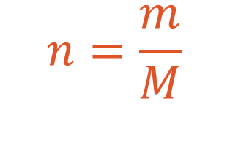
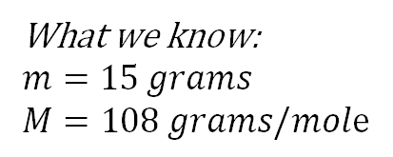

Count with chemical reaktions
Ex: You have a silverring(Ag) that weighs 15 grams, how many silver atoms does the ring contain?
What we know:
$m=15 grams$
$M=108 grams/mole$
$Caculate the amount of substance (n)$
$n=\frac{m}{M}=\frac{15 grams}{108 grams/mole}≈0.14 mole silver atoms$
$$n=\frac{m}{M}$$
$$amount of substance=\frac{mass}{Molar mass}$$
$$mole=\frac{grams}{grams/mole}$$
$$1 mole=6,022∙{10}^{23} pieces (Avogadro´s number)$$

Slide 2
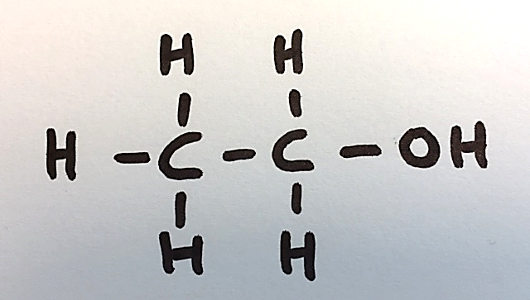
Wich fuel lets out the most amount of carbondioxide, diesel or ethanol?
We get the energy to drive our carengines from a combustion between oxygen and different fuels.
Ethanol
$$C_{2}H_{5}OH\left(g\right)+{3O}_{2}\left(g\right)→2CO_{2}\left(g\right)+{3H}_{2}O(g)$$
Diesel
$${2C}_{14}H_{30}\left(g\right)+{43O}_{2}\left(g\right)→28CO_{2}\left(g\right)+{30H}_{2}O(g)$$

Slide 3

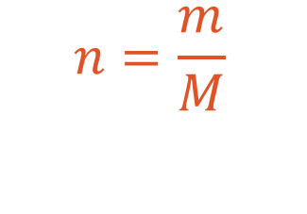
If we burn 1000 grams of fuel, what amount of carbondioxide will be released?
Ethanol
$$C_{2}H_{5}OH\left(l\right) + {3O}_{2}\left(g\right) → 2CO_{2}\left(g\right) + {3H}_{2}O(g)$$
Molar ratio: 1 2
Mass (m): 1000 grams
Molar mass (M): $2∙12,0+6∙1,01+16,0=46,06 grams per mole$ $12,0+2∙16,0=44,0 grams per mole$
Amount of substance (n):
$43,4 mole∙44,0 grams per mole≈1909,6 grams$
$$\frac{1000 g\text{rams} }{46,06 grams per mole}≈21,7 mole$$
$$2∙21,7 mole=43,4 mole$$
$$n=\frac{m}{M}$$
$$m=n∙M$$

Slide 4
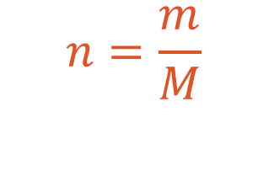

If we burn 1000 grams of fuel, what amount of carbondioxide will be released?
Diesel
$${2C}_{14}H_{30}\left(l\right) +{ 43O}_{2}\left(g\right) → 28CO_{2}\left(g\right) +{ 30H}_{2}O(g)$$
Molar ratio: 1 14
Mass (m): 1000 grams
Molar mass (M): $14∙12,0+30∙1,01=918,3 grams per mole$ $12,0+2∙16,0=44,0 grams per mol$
Amount of substance (n):
$15,26 mole∙44,0 grams per mole≈671 grams$
$$\frac{1000 grams}{918,3grams per mole}≈1,09 mole$$
$$14∙1,09 mole=15,26 mole$$
$$n=\frac{m}{M}$$
$$m=n∙M$$

Slide 5
If we burn 1000 grams of fuel, what amount of carbondioxide will be released?
Conclusion
If we burn 1000 gram of ethanol we release approximately 1900 grams of carbondioxide, if we burn 1000 grams of diesel we release approximetaly 670 grams of carbondioxide. Ethanol releases more carbondioxide than diesel in a combustion reaction.
Discussion
Wich fuel is more environmental friendly?
Are these numbers and calculations enough to support an argument when it comes to discussing environmental friendly fuels? Wich other factors should be regarded as important here?

Slide 6
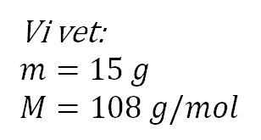
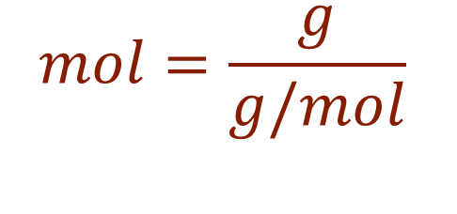
Att räkna i kemiska reaktioner
Ex: Du har fått ett silversmycke (Ag) som väger 15 gram, hur många silveratomer finns i smycket?
Vi vet:
$m=15 g$
$M=108 g/mol$
$Räkna ut substansmängden (n)$
$n=\frac{m}{M}=\frac{15 g}{108 g/mol}≈0.14 mol$
$$n=\frac{m}{M}$$
$$substansmängd=\frac{massa}{molmassa}$$
$$mol=\frac{g}{g/mol}$$
$$1 mol=6,022∙{10}^{23}st$$

Slide 7
Vilket bränsle släpper ut mest koldioxid, diesel eller etanol?
Vi får energi till att driva en bilmotor genom en förbränningsreaktion mellan syre och olika bränslen.
Etanol
$$C_{2}H_{5}OH\left(g\right)+{3O}_{2}\left(g\right)→2CO_{2}\left(g\right)+{3H}_{2}O(g)$$
Disel
$${2C}_{14}H_{30}\left(g\right)+{43O}_{2}\left(g\right)→28CO_{2}\left(g\right)+{30H}_{2}O(g)$$

Slide 8
Om vi eldar 1000 g bränsle hur mycket koldioxid släpps ut?
Etanol
$$C_{2}H_{5}OH\left(l\right) + {3O}_{2}\left(g\right) → 2CO_{2}\left(g\right) + {3H}_{2}O(g)$$
Molförhållande: 1 2
Massa (m): 1000 g
Molmassa (M): $2∙12,0+6∙1,01+16,0=46,06 g/mol$ $12,0+2∙16,0=44,0 g/mol$
Substansmängd (n):
$43,4 mol∙44,0g/mol≈1909,6g$
$$\frac{1000 g }{46,06g/mol}≈21,7 mol$$
$$2∙21,7 mol=43,4 mol$$
$$n=\frac{m}{M}$$
$$m=n∙M$$

Slide 9
Om vi eldar 1000 g bränsle hur mycket koldioxid släpps ut?
Disel
$${2C}_{14}H_{30}\left(l\right) +{ 43O}_{2}\left(g\right) → 28CO_{2}\left(g\right) +{ 30H}_{2}O(g)$$
Molförhållande: 1 14
Massa (m): 1000 g
Molmassa (M): $14∙12,0+30∙1,01=918,3 g/mol$ $12,0+2∙16,0=44,0 g/mol$
Substansmängd (n):
$15,26 mol∙44,0 g/mol≈671g$
$$\frac{1000 g }{918,3g/mol}≈1,09 mol$$
$$14∙1,09 mol=15,26 mol$$
$$n=\frac{m}{M}$$
$$m=n∙M$$

Slide 10
Om vi eldar 1000 g bränsle hur mycket koldioxid släpps ut?
Slutsats
Om vi eldar 1000 gram etanol bildas det ca 1900 g koldioxid, om vi eldar 1000 g diesel bildas det ca 670 g koldioxid. Etanol släpper ut mer koldioxid än diesel vid en förbränningsreaktion.
Vilket är mest miljövänligt?
Räcker det att ha dessa beräkningar som underlag om man diskuterar hur miljövänliga bränslen är?

